Slide 1
SINGLY LINKED LIST AND OPERATIONS WITH C IMPLEMENTATION
Data Structures and Algorithms
An Introduction to Dynamic Linear Data Structures
Prof. Rohit Pal Singh

Slide 2
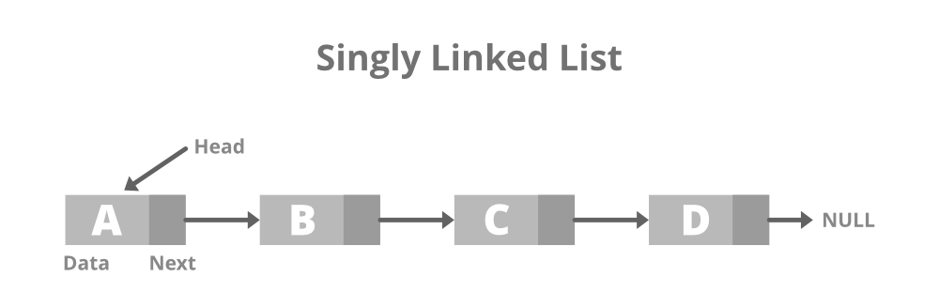
What is a Linked List?
Definition: A linear data structure where elements are stored in nodes
Each node contains:
  Data: The actual value/information
  Next: Pointer/Reference to the next node
Visual Representation:
Key Feature: Dynamic size (grows/shrinks at runtime)
Memory Representation:
Nodes are not stored contiguously in memory
Each node allocated separately
Connected via pointers/references

Slide 3
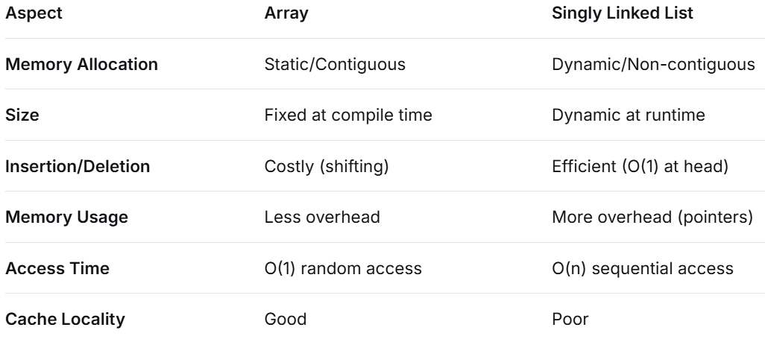
Singly Linked List vs Array

Slide 4
Basic Operations Overview
Traversal - Visit each node
Insertion - Add node at:
  Beginning
  End
  Specific position
Deletion - Remove node from:
  Beginning
  End
  Specific position
Search - Find a node with given value
Display - Print all elements

Slide 5
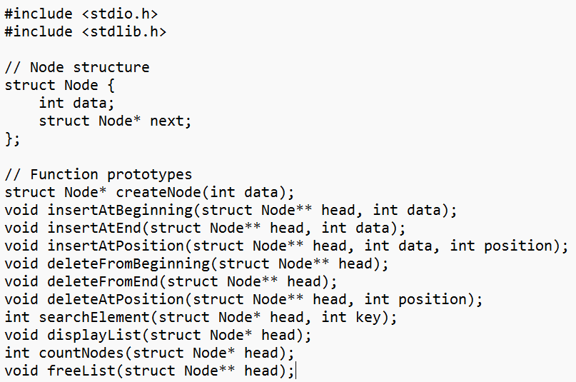
Complete C Program Structure

Slide 6
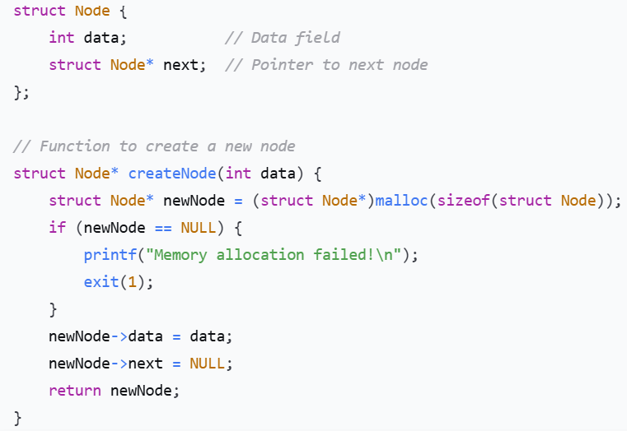
Node Structure & Creation Function

Slide 7
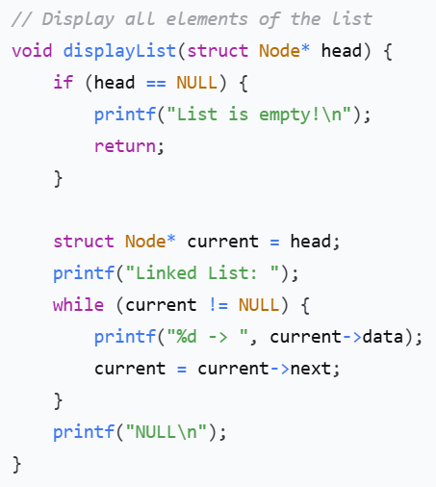
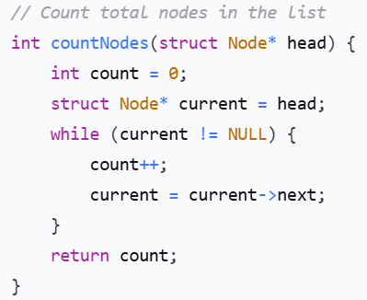
Display List & Count Nodes

Slide 8
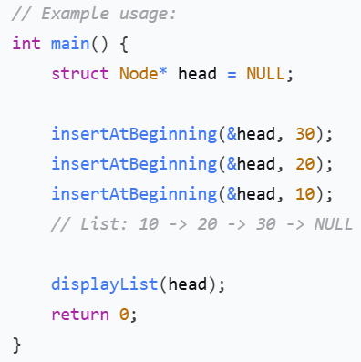
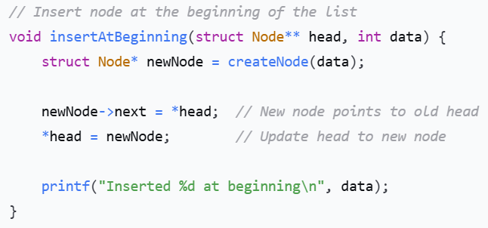
Insertion at Beginning (C Code)

Slide 9
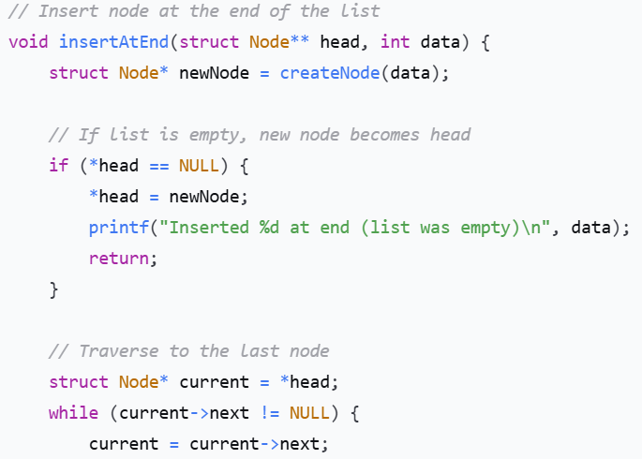
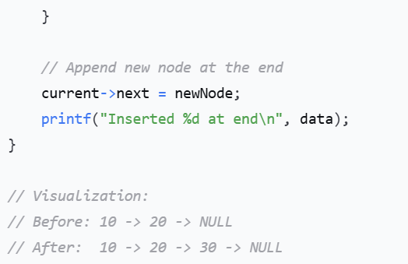
Insertion at End (C Code)

Slide 10
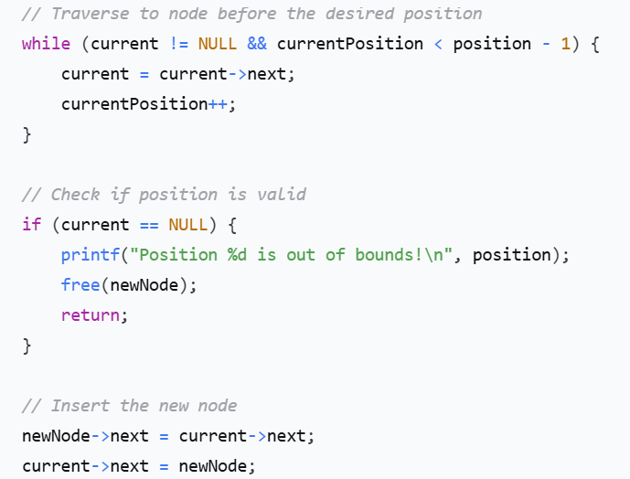
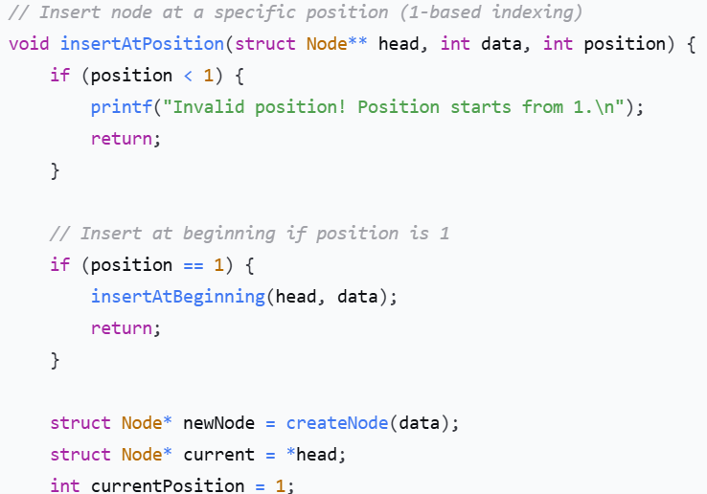
Insertion at Specific Position (C Code)

Slide 11
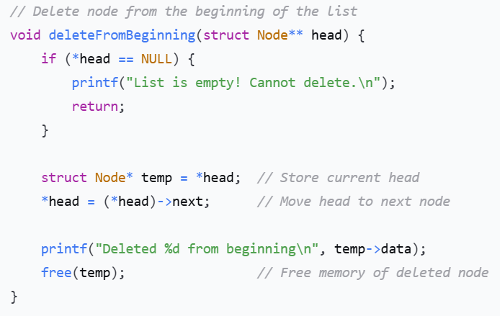
Deletion from Beginning (C Code)

Slide 12
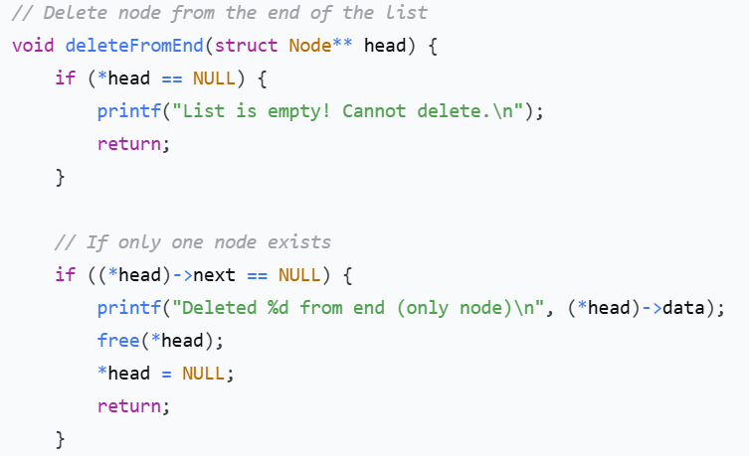
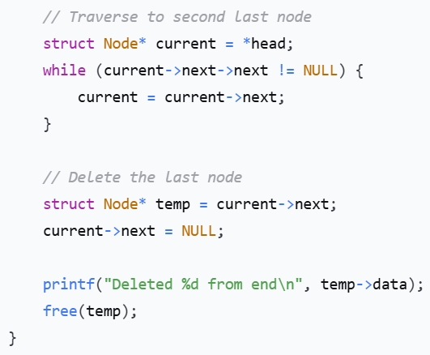
Deletion from End (C Code)

Slide 13
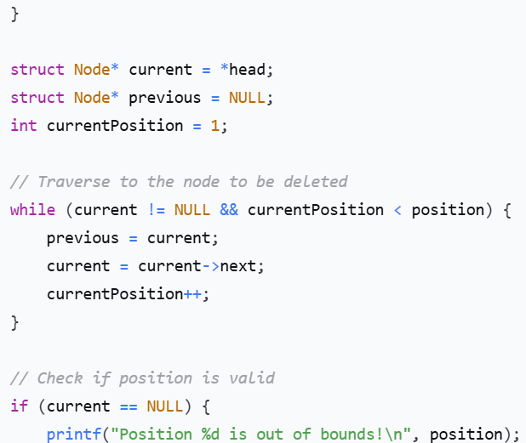
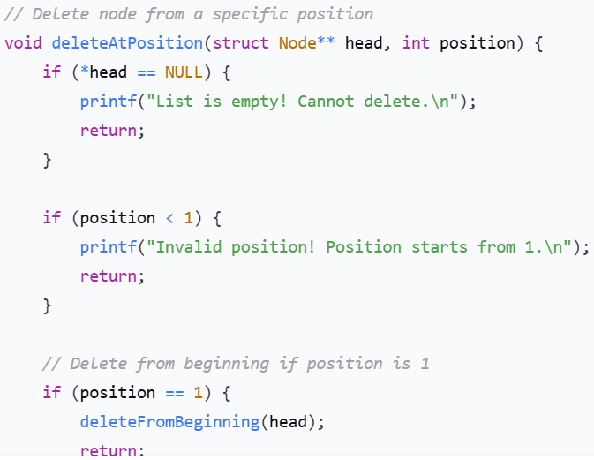
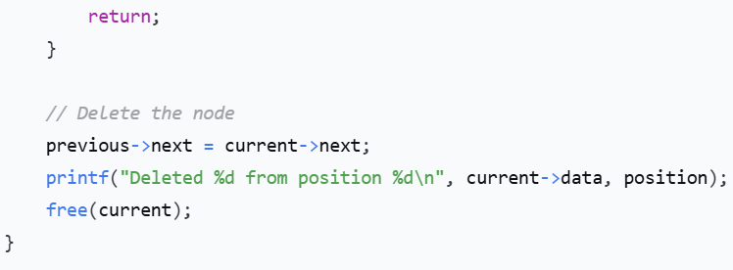
Deletion at Specific Position (C Code)

Slide 14
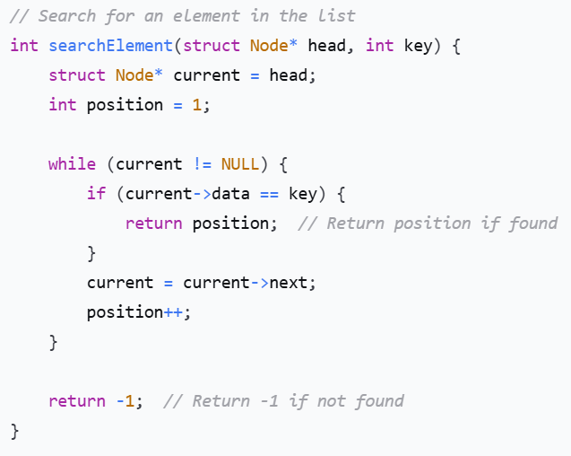
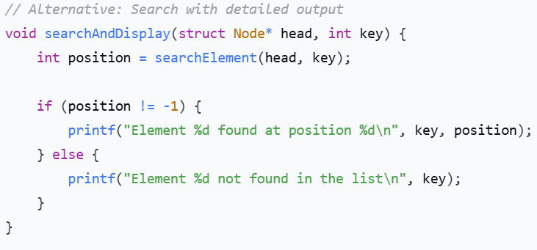
Search Operation (C Code)

Slide 15
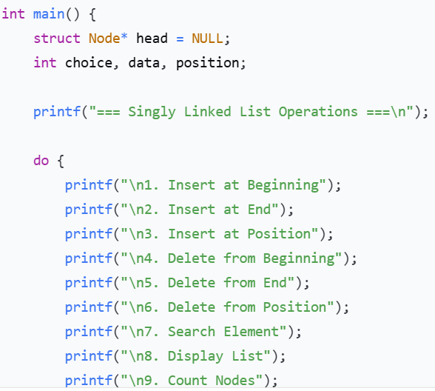
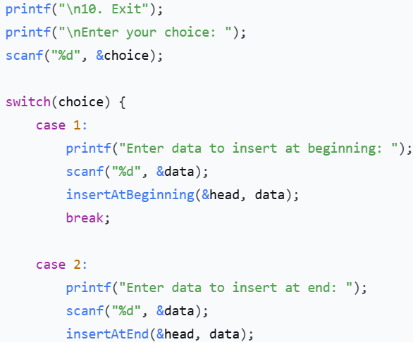
Complete Main Function Example

Slide 16
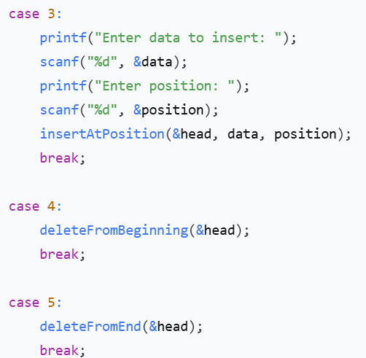
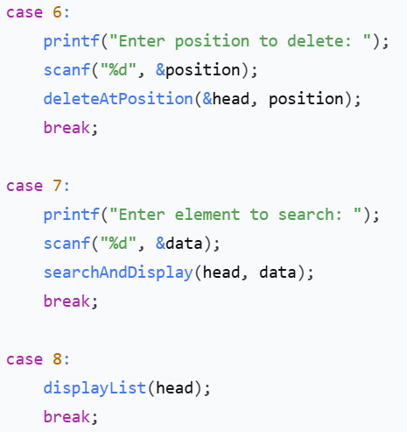
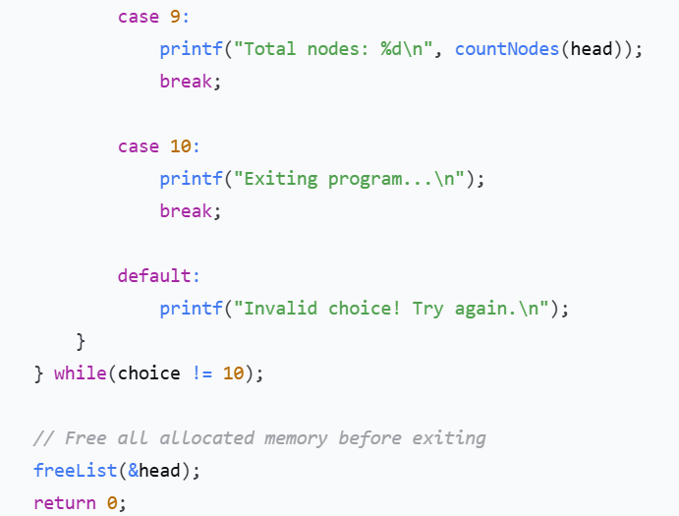

Slide 17
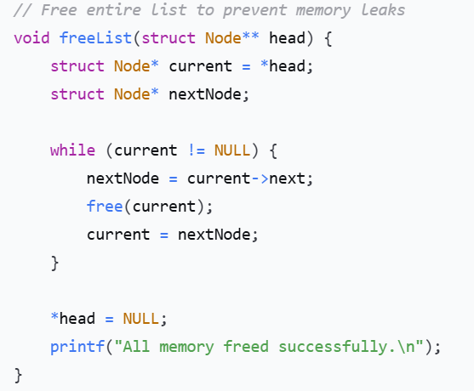
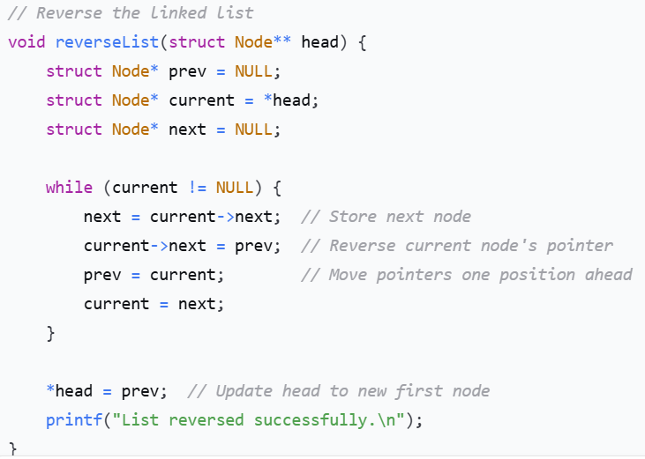
Memory Management & Utility Functions

Slide 18
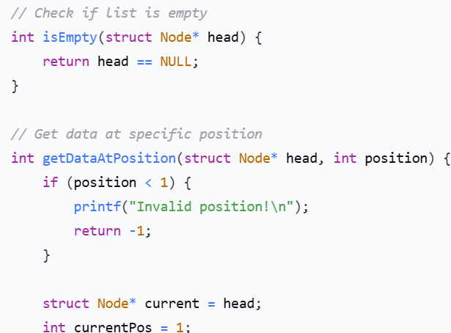
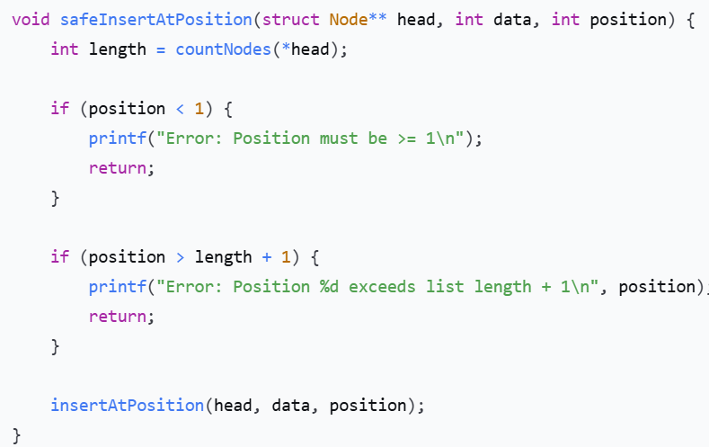
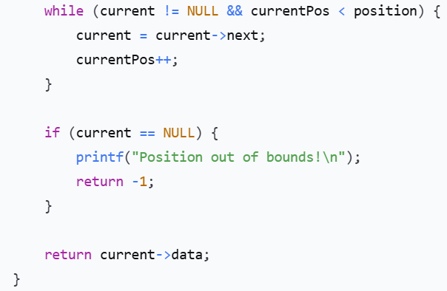
Error Handling & Edge Cases

Slide 19
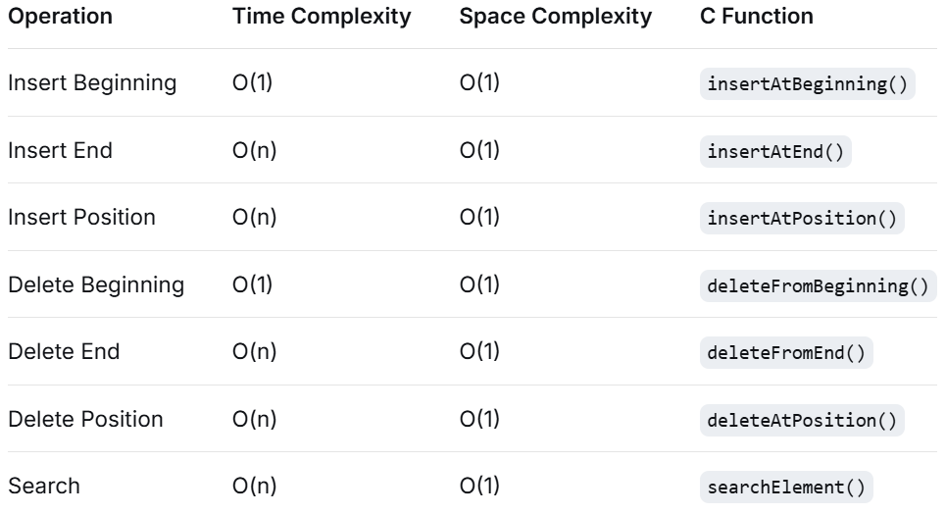
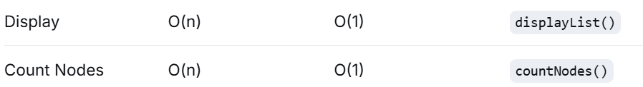
Time & Space Complexity Analysis

Slide 20
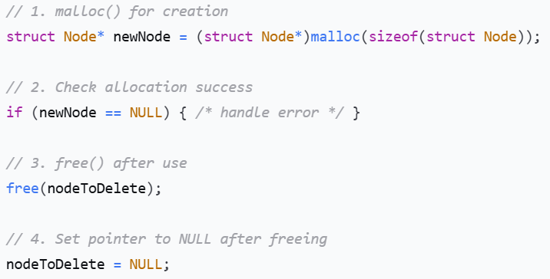
Summary & Best Practices
Key Points:
  Always check for NULL before dereferencing pointers
  Use double pointers (**head) when modifying head
  Free memory after deletion to prevent leaks
  Handle edge cases (empty list, single node, invalid positions)
  Use helper functions for common operations
Memory Management Rules:

Slide 21
Advantages and Disadvantages
Pros
Dynamic Size: Grows/shrinks as needed
Efficient Insertions/Deletions: No shifting required
Memory Efficiency: Use only needed memory
Easy Implementation: Simple structure
Foundation: Basis for other structures (stacks, queues)
Cons
Memory Overhead: Extra pointer for each node
Sequential Access: No random access (must traverse)
Reverse Traversal Difficult: Cannot move backward
Cache Unfriendly: Non-contiguous memory
Complex Implementation: More error-prone than arrays

Slide 22
Common Interview Questions
Reverse a linked list
Detect loop/cycle
Find middle element
Merge two sorted lists
Find nth node from end
Remove duplicates
Check palindrome
Intersection point of two lists

Slide 23
Thank You

